Slide 1
Political juggernauts:A Quantative Analysis of Candidates In The 2019 Lok Shabha Election
Team leader:
Prabakaran.R
Team Members:
Prithivraj.M
Sai Kumar.M
Ragu.S
Our Mentor:
Dr.N.Manimegalai
College Name: Government Arts College for Men Krishnagiri-635001
Department:III B Sc., Mathematics

Slide 2
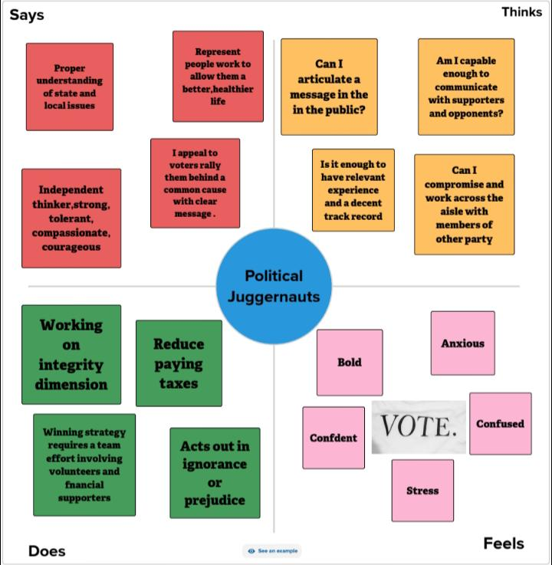
Emphaty map

Slide 3
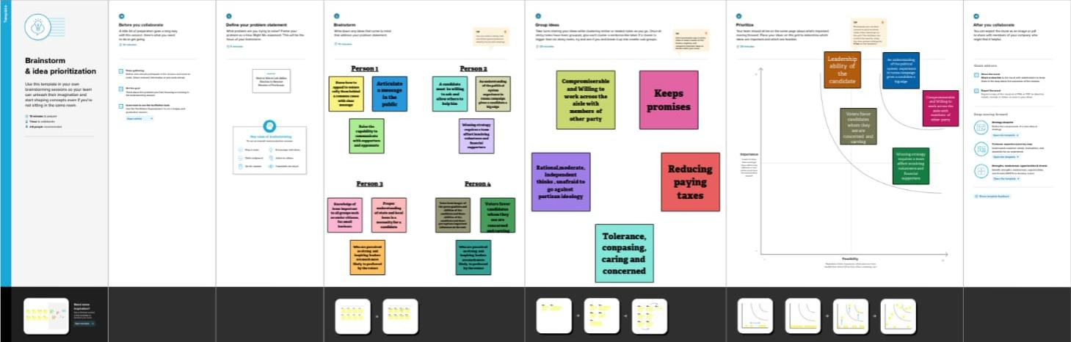
Brainstorming Map

Slide 4
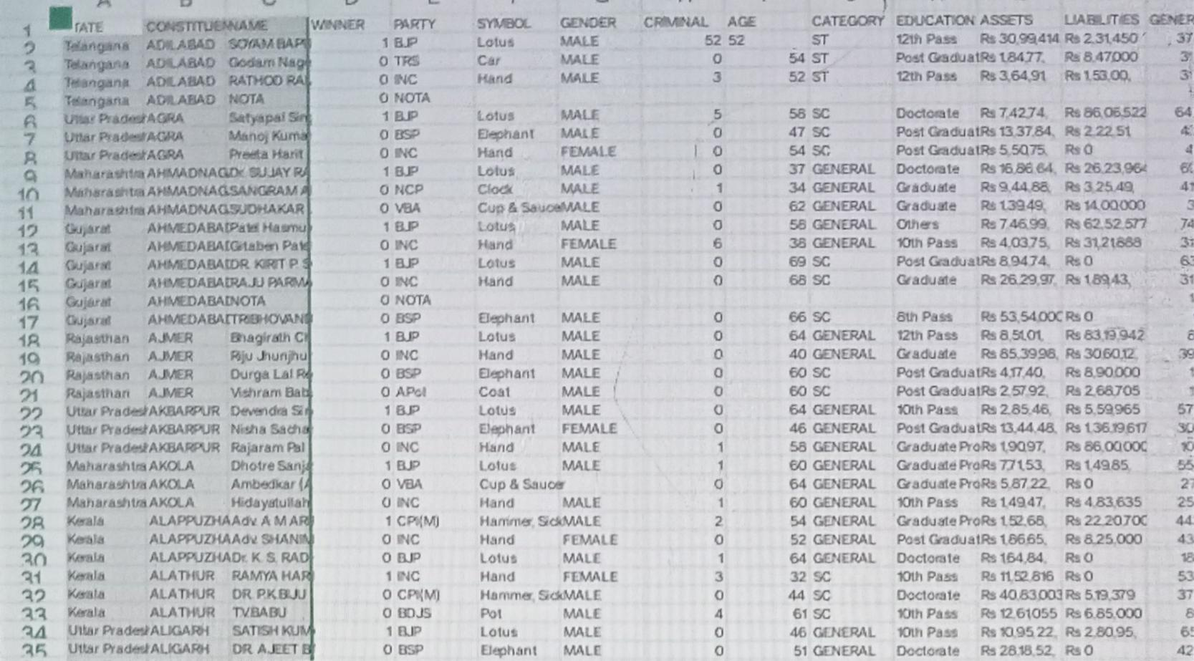
Data set

Slide 5
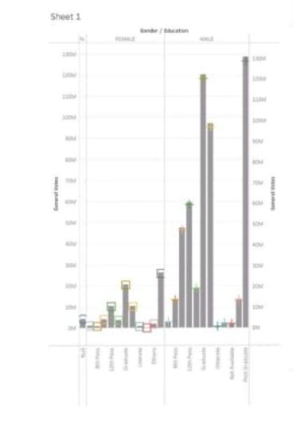
Sheet 1

Slide 6
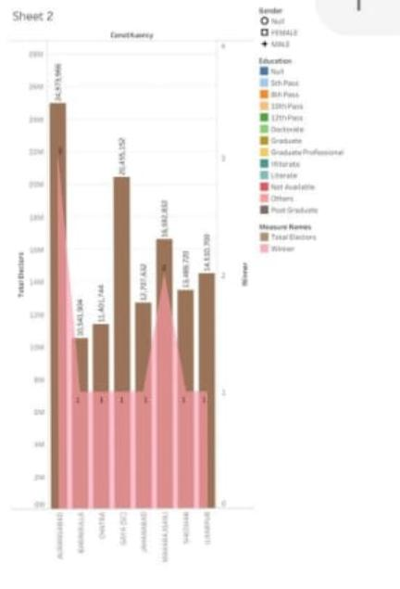
Sheet 2

Slide 7
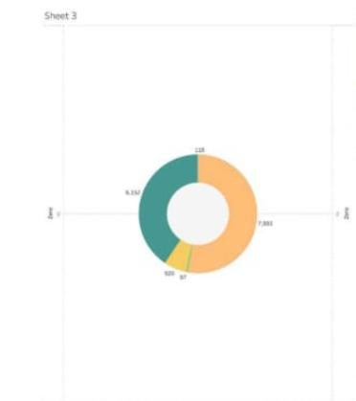
Sheet 3

Slide 8
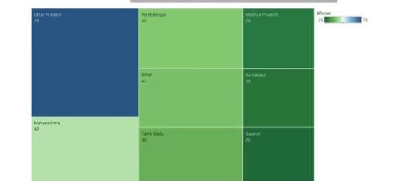
Sheet 4

Slide 9
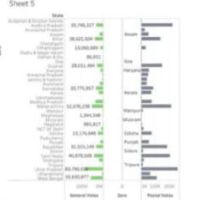
Sheet 5

Slide 10
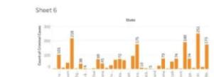
Sheet 6

Slide 11

Sheet 7

Slide 12
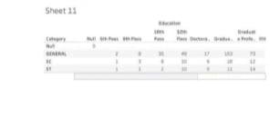
Sheet 11

Slide 13

Sheet 12

Slide 14

Sheet 13

Slide 15
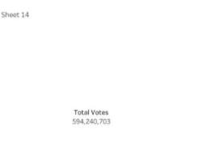
Sheet 14

Slide 16
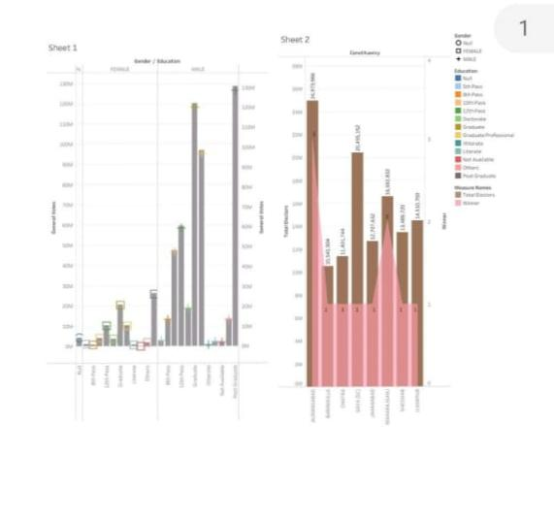
Dashboard 1

Slide 17
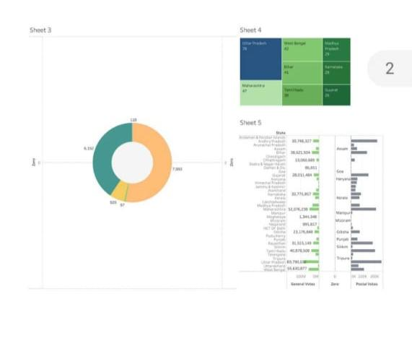
Dashboard 2

Slide 18
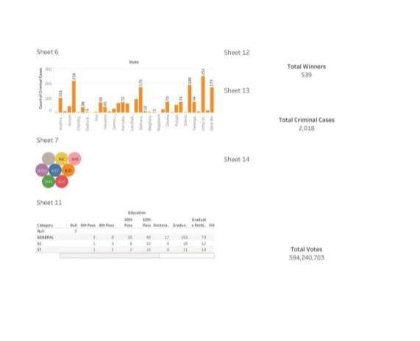
Dashboard 3

Slide 19
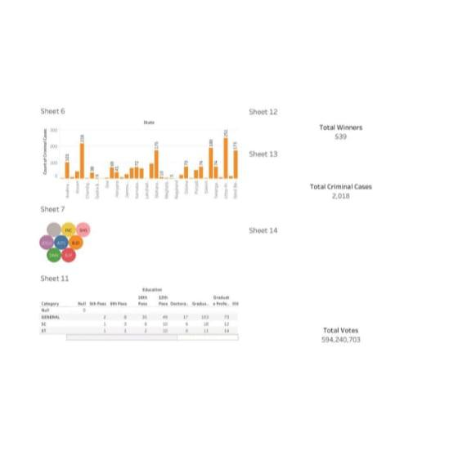
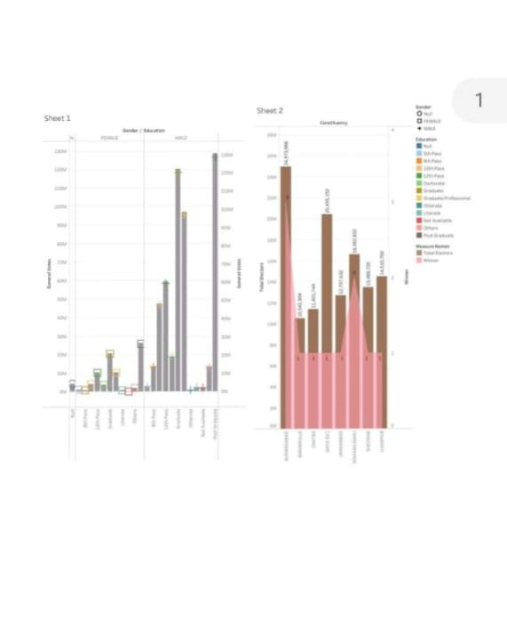
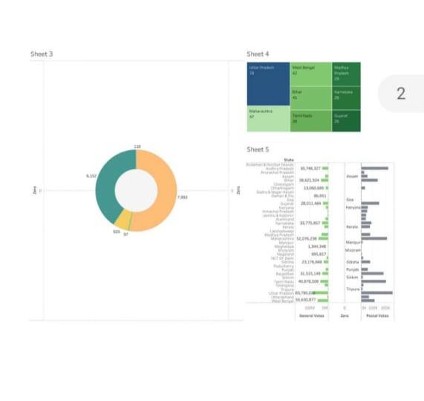
Story

